Slide 1
Capstone Project - 2 Appliances Energy Prediction Team Members Rutvina L. Papadkar Sagar Khairkar Nayan Rewatkar

Slide 2
Table of content
Importing the Relevant Libraries
Data Inspection
Exploratory Data Analysis
Feature selection
Feature engineering
Train and Test split
Model training
Cross validation
Model Explainability
Conclusion

Slide 3
Problem Statement The data set is at 10 min for about 4.5 months. The house temperature and humidity conditions were monitored with a ZigBee wireless sensor network. Each wireless node transmitted the temperature and humidity conditions around 3.3 min. Then, the wireless data was averaged for 10 minutes periods. The energy data was logged every 10 minutes with mbus energy meters. Weather from the nearest airport weather station (Chievres Airport, Belgium) was downloaded from a public data set from Reliable Prognosis (rp5.ru) and merged together with the experimental data sets using the date and time column. Two random variables have been included in the data set for testing the regression models and to filter out non-predictive attributes (parameters).

Slide 4
Objective Energy usage is rapidly increasing in today's world. We are experiencing a lack of energy due to the increased energy consumption in some regions of the world, which is causing environmental damage. Our main purpose in this project is to analyse what factors are affecting the increase energy consumption of home appliances, how we may reduce energy consumption of home appliances, and predict energy consumption of appliances using regression models

Slide 5
Data set information Columns Used: Date time year-month-day hour:minute:second Appliances, energy use in Wh Lights, energy use of light fixtures in the house in Wh T1, Temperature in kitchen area, in Celsius RH_1, Humidity in kitchen area, in % T2, Temperature in living room area, in Celsius RH_2, Humidity in living room area, in % T3, Temperature in laundry room area RH_3, Humidity in laundry room area, in % T4, Temperature in office room, in Celsius RH_4, Humidity in office room, in % T5, Temperature in bathroom, in Celsius RH_5, Humidity in bathroom, in % T6, Temperature outside the building (north side), in Celsius RH_6, Humidity outside the building (north side), in %

Slide 6
T7, Temperature in ironing room , in Celsius RH_7, Humidity in ironing room, in % T8, Temperature in teenager room 2, in Celsius RH_8, Humidity in teenager room 2, in % T9, Temperature in parents room, in Celsius RH_9, Humidity in parents room, in % To, Temperature outside (from Chievres weather station), in Celsius Pressure (from Chievres weather station), in mm Hg RH_out, Humidity outside (from Chievres weather station), in % Wind speed (from Chievres weather station), in m/s Visibility (from Chievres weather station), in km 27. Tdewpoint (from Chievres weather station), Â°C 28. rv1, Random variable 1, nondimensional 29. rv2, Random variable 2, nondimensional

Slide 7
Data Inspection From the statistics part of our data we can observe: There are 29 columns and 19735 rows in our dataset. The maximum energy consumption of the appliance is 1080 watts, while the minimum is 10 watts. The majority of the data in the light column are 0 values. The maximum pressure outside the home is 772.3 mm hg. There are no categorical columns in the dataset other than the date column. Average temperature outside is about 7.5 degrees. While it ranges from -6 to 28 degrees. There are no null or missing values. Outside humidity is higher than inside humidity. The maximum wind speed is 14 m/s.

Slide 8
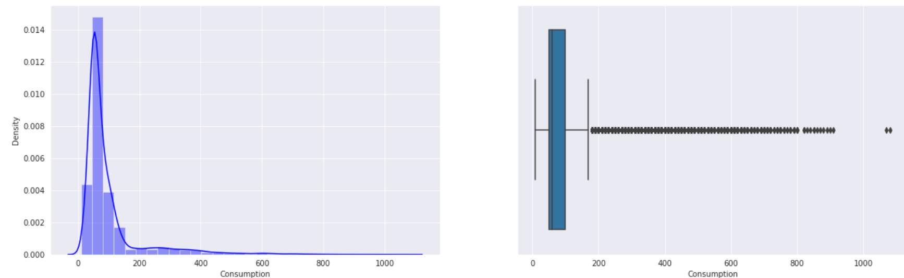
Exploratory Data Analysis Checking distribution of target variable Observation: Since our graph is positively skewed, it is moving towards the y axis, and we couldn't get a better visualisation with this type of graph. As a result, it is better to apply a Log, Square Root, or Exponential transformation and check the dependent variable's distribution.

Slide 9
To check the distribution using Log transformation method on dependent variable Observation: It almost has a normal distribution after the log10 transformation.

Slide 10
Checking distribution of all the features Except for lights, T2, RH6, RH out, windspeed, rv1 and rv2, the rest columns are normally distributed.

Slide 11
Observation 1) Positively skewed(>1):- Appliances, RH_5. 2) Moderately Positively skewed(0.5 to 1):- T2, T5, T6, T_out, RH_out, Windspeed. 3) Normal Distributed(-0.5 to +0.5):- T1, T3, T4, T7, T8, T9, RH_1, RH_2, RH_3, RH_4, RH_6, RH_7, RH_8, RH_9, Press_mm_hg, Visibility, Tdewpoint, rv1, rv2, 4) Negative skewed(-0.5 to -1):- No features. 5) Moderately Negatively skewed(>-1):- RH_out.

Slide 12
Checking which day of week has more energy consumption? 0 - Sunday has a higher energy consumption rate, which indicates that more individuals are at home on Sunday.

Slide 13
Correlation feature selection

Slide 14
Observations based on correlation plot Temperature - All the temperature variables from T1-T9 and T_out have positive correlation with the target Appliances. For the indoor temperatures, the correlations are high as expected, since the ventilation is driven by the HRV unit and minimizes air temperature differences between rooms. Five columns have a high degree of correlation with T9 - T3,T4,T5,T7,T8 also T6 & T_Out has high correlation(both temperatures from outside) . Hence T6 and T9 can be removed from training set as information provided by them can be provided by other fields. Weather attributes - Visibility, Tdewpoint, Press_mm_hg have low correlation values Humidity -There are no significantly high correlation cases (> 0.9) for humidity sensors. Random variables have no role to play

Slide 15
Summary: The summary plot combines the relevance of features with the effects of features. Each point on the summary plot represents a Shapley value for a single instance of a feature. The feature determines the position on the y-axis, and the Shapley value of each instance determines the position on the x-axis. You can see that the most essential feature, the hour, has a high Shapley value range. The colour denotes the feature's value, which ranges from low to high. Overlapping points are jittered in the y-axis direction to give us a sense of the Shapley value distribution per feature. The features are arranged in descending order of importance.

Slide 16
Conclusion: Many columns in the dataset are not normally distributed, and the target column is also right skewed. The dataset has many outliers and no null values. We have a high correlation with the dependent variable in the hours column, and many features have less than a 0.1 correlation with the dependent variable in the non linear dataset. Energy consumption is high in March and low in January, and a rise in temperature results in higher energy consumption. Decreased humidity leads to an increase in electricity consumption. Humidity is proportional to the dependent variable. The most important determining factor for energy consumption is the hour of day. During the evening hours of 16:00 to 20:00, there is a high usage of electricity of more than 140Wh. Electricity use is highest on weekends (Saturdays and Sundays). (more than 25% higher than on weekdays) As a feature, lights are extremely undervalued.

Slide 17
We excluded features that were not important for predicting the dependent variable using a variance threshold, f regression, and the Pearson correlation matrix. We removed outliers from our model using feature engineering. Implementing the XGBM and LGBM regression algorithms was done along with cross validation and hyperparameter adjustment on all models. Decision tree, Random forest, Gradient Boosting, and Linear Regression were also used. In a comparison of all models, the Random Forest regressor is the best, having a high r2 score, a low MSE, and a low RMSE value. Due to the time series nature of the dataset and the lack of time series concept implementation, some overfitting is occurring. The model explainability Shap approach is used to determine which attributes are crucial for predicting output and understanding the model. The most significant feature is the hour feature.

Slide 18


